Slide 1

Community Detection
Lei Zou
Peking University
zoulei@pku.edu.cn

Slide 2
Outline
Introduction
Hierarchical clustering
Betweenness-based Approach
Clique and Clique Percolation.
K-core
Community-Affiliation Graph
Community Search
Graph Partitioning

Slide 3
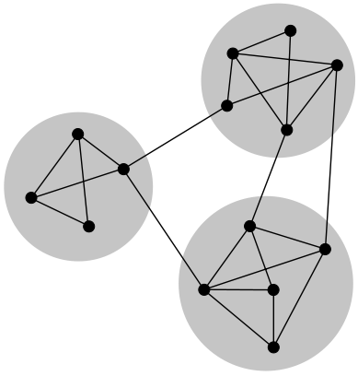
Community Structures
Subsets of vertices within the communities are dense, but between the communities
are less dense.

Slide 4
Part 1
Community Detection Algorithms

Slide 5
Community
Subsets of vertices within the communities are dense, but between the communities
are less dense.

Slide 6
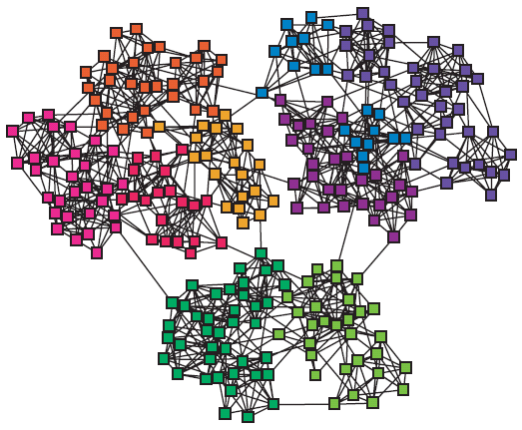
Community
Real-world networks are often organized into modules, cluster, communities

Slide 7
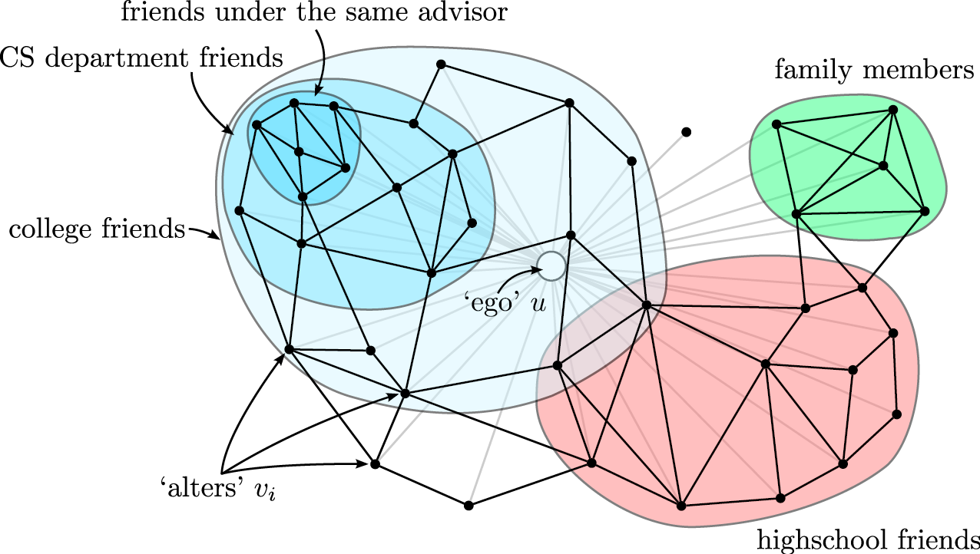
Community

Slide 8
Traditional methods: hierarchical clustering
Compute weights W_{ij} for each pair of vertices
choices
# of node independent paths between vertices
equal to the minimum number of vertices that must be removed from the graph to disconnect i and j from one another
W_{ij} = 2
# all paths between vertices (weighted by length of path, α^{L}, α<1)

Slide 9
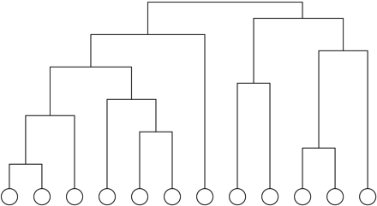
Traditional methods: hierarchical clustering
Process:
after calculating the weights W for all pairs of vertices
start with all n vertices disconnected
add edges between pairs one by one in order of decreasing weight
result: nested components, where one can take a ‘slice’ at any level of the tree

Slide 10
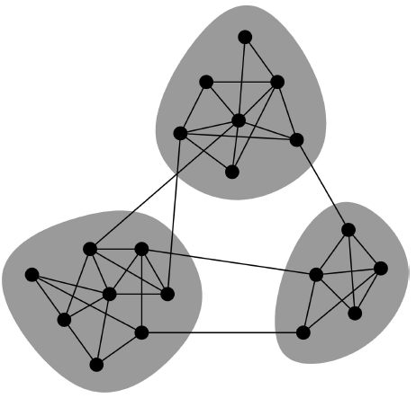
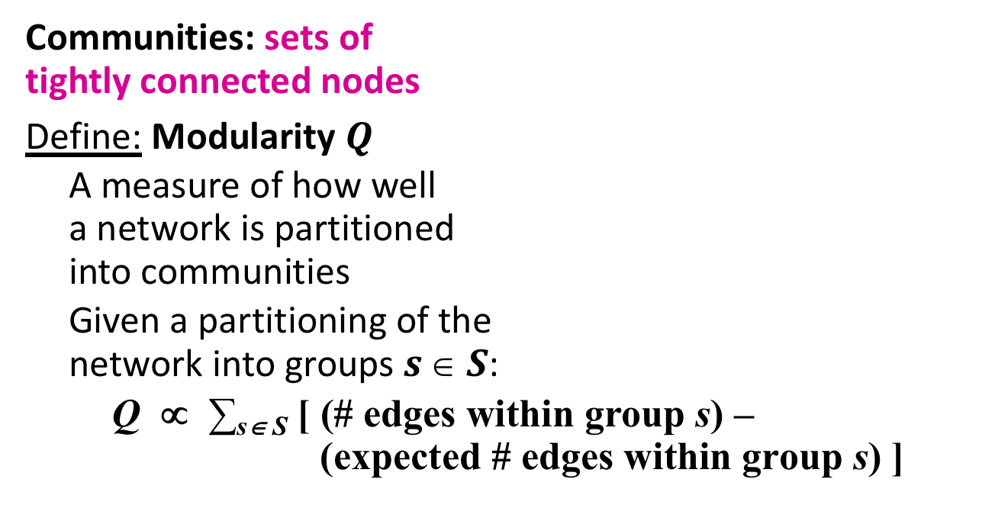
Network Communities and Modularity
Communities: sets of tightly connected nodes
Define: Modularity $Q$
A measure of how well a network is partitioned into communities
Given a partitioning of the network into groups $s  S$:
Q ∝ ∑_{s∈ S} [ (# edges within group s) – (expected # edges within group s) ]

Slide 11
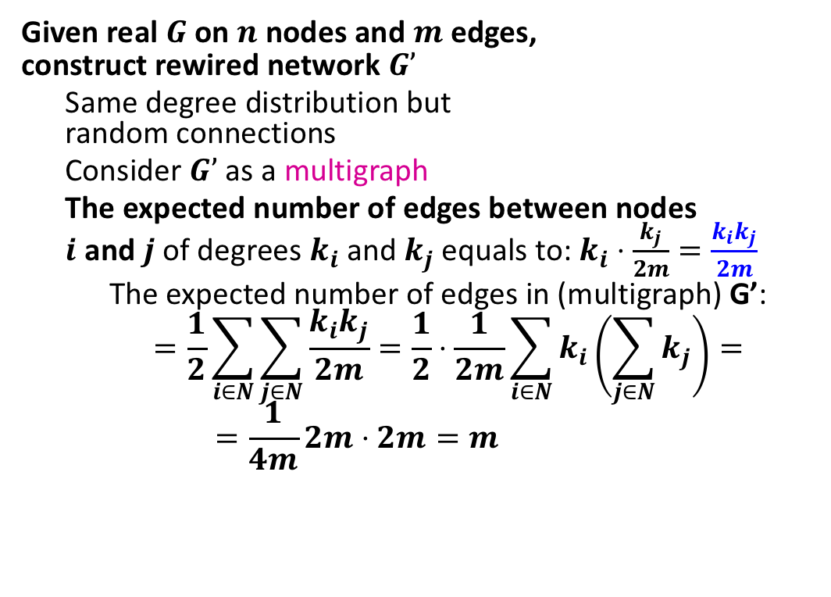
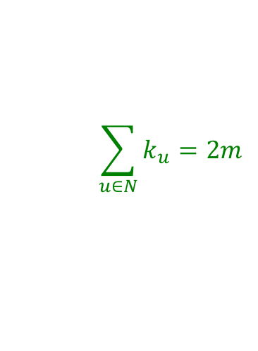
Network Communities and Modularity
Null Model: Configuration Model
Given real $G$ on $n$ nodes and $m$ edges, construct rewired network $G’$
Same degree distribution but random connections
Consider $G’$ as a multigraph
The expected number of edges between nodes $i$ and $j$ of degrees $k_{i}$and $k_{j}$ equals to: $k_{i}⋅\frac{k_{j}}{2m}=\frac{k_{i}k_{j}}{2m}$
The expected number of edges in (multigraph) G’:
$$=\frac{1}{2}\sum_{i∈N}{\sum_{j∈N}{\frac{k_{i}k_{j}}{2m}}}=\frac{1}{2}⋅\frac{1}{2m}\sum_{i∈N}{k_{i}\left(\sum_{j∈N}{k_{j}}\right)}=$$
$$=\frac{1}{4m}2m⋅2m=m$$
i
j
The possibility of one edge that is adjacent to node j.
Note:
$$\sum_{u∈N}{k_{u}}=2m$$
Notes:
假设每个节点表示为一个star结构，所有节点的star的边数总和为2m。

Slide 12
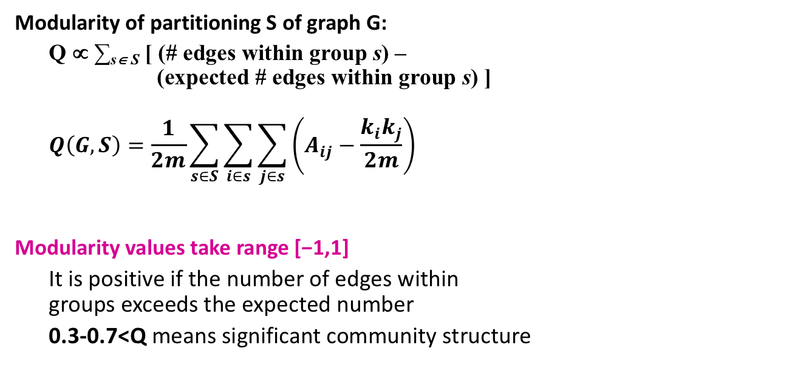
Network Communities and Modularity
Modularity of partitioning S of graph G:
Q ∝ ∑_{s∈ S} [ (# edges within group s) – (expected # edges within group s) ]
$$Q\left(G,S\right)=\frac{1}{2m}\sum_{s∈S}{\sum_{i∈s}{\sum_{j∈s}{\left(A_{ij}−\frac{k_{i}k_{j}}{2m}\right)}}}$$
Modularity values take range [−1,1]
It is positive if the number of edges within groups exceeds the expected number
0.3-0.7<Q means significant community structure
A_{ij} = 1 if i→j, 0 else
Normalizing cost.: -1<Q<1

Slide 13
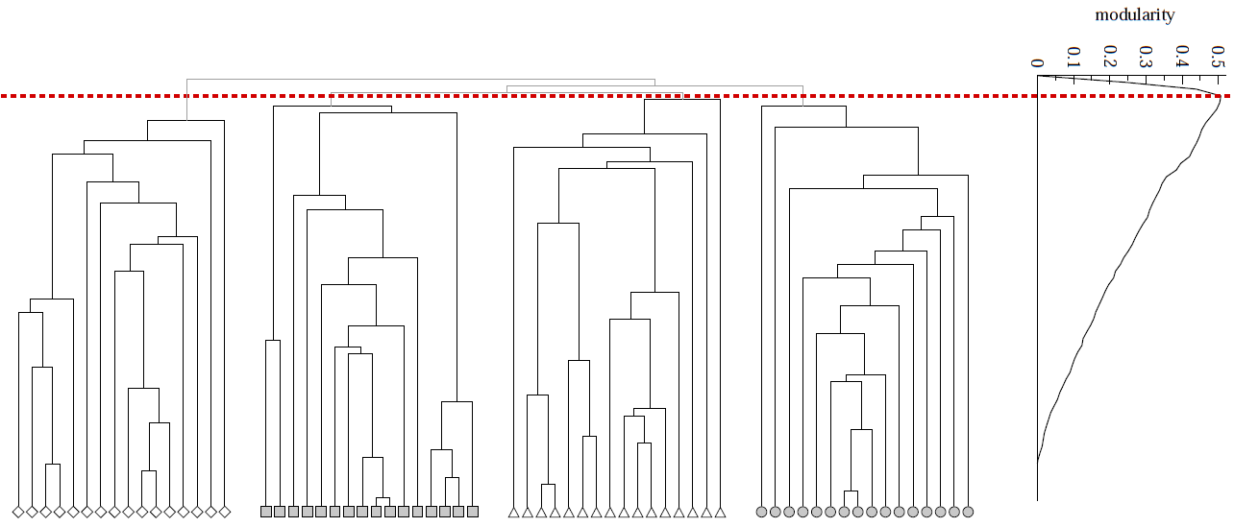
Network Communities and Modularity
Modularity is useful for selecting the number of clusters:

Slide 14
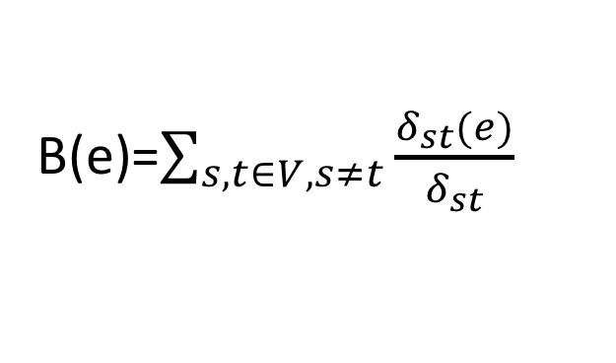
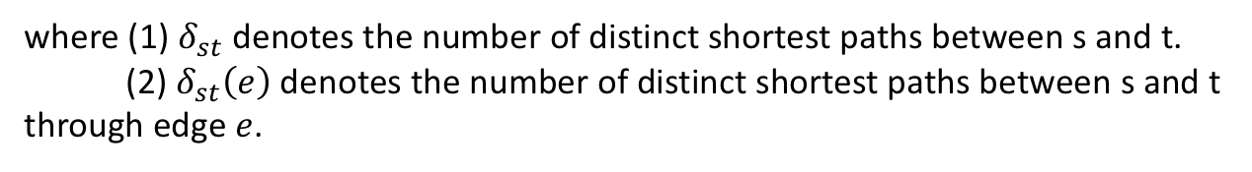
Edge “Betweenness” and Community Structure
Edge Betweenness:
For each edge, the edge betweenness is the number of shortest paths between pairs of vertices that run along it.
b=16
b=7.5
B(e)=$\sum_{s,t∈V,s≠t}{\frac{δ_{st}(e)}{δ_{st}}}$
where (1) $δ_{st}$ denotes the number of distinct shortest paths between s and t.
(2) $δ_{st}\left(e\right)$ denotes the number of distinct shortest paths between s and t through edge $e$.

Slide 15
Edge “Betweenness” and Community Structure
Intuition:
If a network contains communities or groups that are only loosely connected by a few intergroup edges, then all shortest paths between different communities or groups must go along one of these few edges.
Thus, the edges connecting communities will have high edge betweenness.
b=16
b=7.5

Slide 16
Edge “Betweenness” and Community Structure
[Girvan and Newman, PNAS 2002]
Algorithm
compute the betweenness of all edges
while (betweenness of any edge > threshold):
remove edge with highest betweenness
recalculate betweenness
Betweenness needs to be recalculated at each step
removal of an edge can impact the betweenness of another edge
very expensive: all pairs shortest path
may need to repeat up to N times
does not scale to more than a few hundred nodes, even with the fastest algorithms

Slide 17
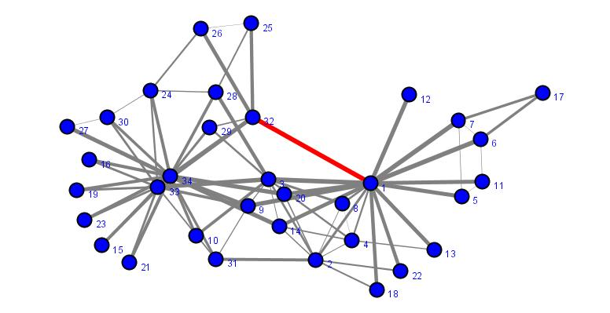
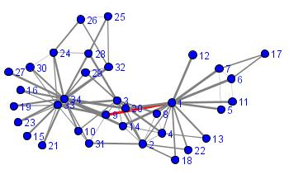
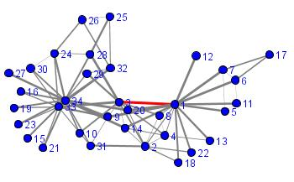
Edge “Betweenness” and Community Structure

Slide 18
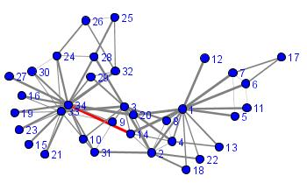
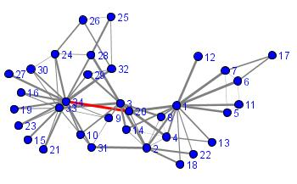
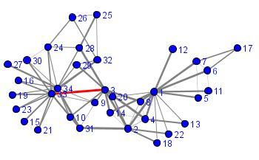
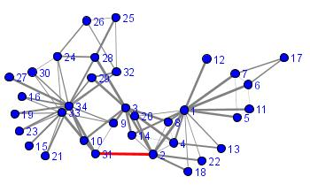
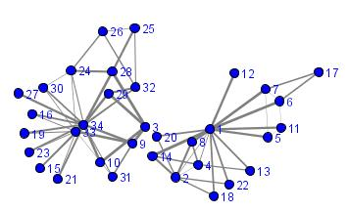
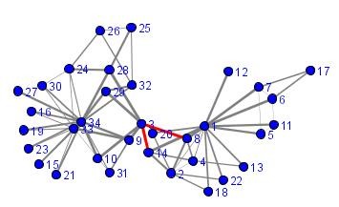
Edge “Betweenness” and Community Structure
separation complete
+ deletion of the edge 2-3

Slide 19
Edge “Betweenness” and Community Structure
separation complete
+ deletion of the edge 2-3

Slide 20
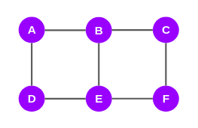
Compute Edge Betweenness Centrality (EBC)
We will take one node at a time and plot the shortest paths to the other nodes from the selected node
Based on the shortest paths, we will compute the EBC scores for all the edges
We need to repeat this process for every node in the graph. In the example graph, we have 6 nodes in the graph above. Therefore, there will be 6 iterations of this process
This means every edge will get 6 scores. These scores will be added edge-wise
Finally, the total score of each edge will be divided by 2 to get the EBC score

Slide 21
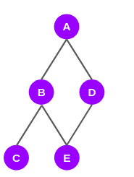
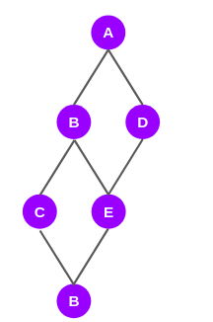
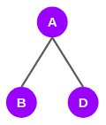
Compute Edge Betweenness Centrality (EBC)
1. Do BFS Search from vertex A
The graph above depicts only the shortest paths from node A to all the other nodes.
Notes:
1. let’s start with node A. The directly connected nodes to node A are nodes B and D. So, the shortest paths to B and D from A are AB and AD respectively.
2. It turns out that the shortest paths to nodes C and E from A go through B and D:
3. The shortest paths to the last node F from node A, pass through nodes B, D, C, and E:

Slide 22
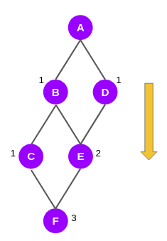
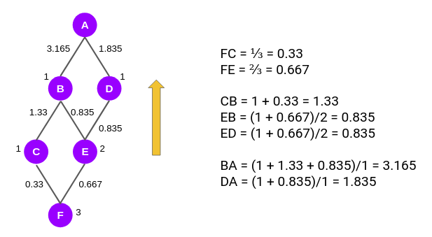
Compute Edge Betweenness Centrality (EBC)
2. Compute Edge Score
Notes:
1. nodes B and D have been given a score of 1 each. This is because the shortest path to either node from node A is only one. For the very same reason, node C has been given a score of 1 as there is only one shortest path from node A to node C.
Moving on to node E. It is connected to node A through two shortest paths, ABE and ADE. Hence, it gets a score of 2.
The last node F is connected to A through three shortest paths — ABCF, ABEF, and ADEF. So, it gets a score of 3. 2. We first compute the score for the edges FC and FE. As you can see, the edge score for edge FC is the ratio of the node scores of C and F, i.e. 1/3 or 0.33. Similarly, for FE the edge score is 2/3.
Now we have to calculate the edge score for the edges CB, EB, and ED. According to the Girvan-Newman algorithm, from this level onwards, every node will have a default value of 1 and the edge scores computed in the previous step will be added to this value.
So, the edge score of CB is (1 + 0.33)/1. Similarly, edge score EB or ED is (1 + 0.667)/2. Then we move to the next level to calculate the edge scores for BA and DA.

Slide 23
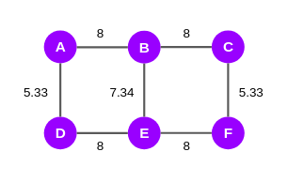
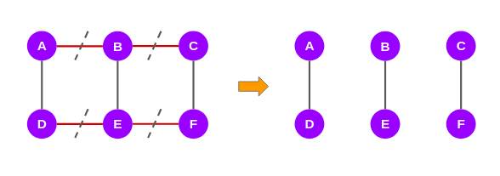
Compute Edge Betweenness Centrality (EBC)
Notes:
we have computed the edge scores of the shortest paths with respect to node A. We will have to repeat the same steps again from the other remaining five nodes. In the end, we will get a set of six scores for all the edges in the network. We will add these scores and assign them to the original graph
we have computed the edge scores of the shortest paths with respect to node A. We will have to repeat the same steps again from the other remaining five nodes. In the end, we will get a set of six scores for all the edges in the network. We will add these scores and assign them to the original graph

Slide 24
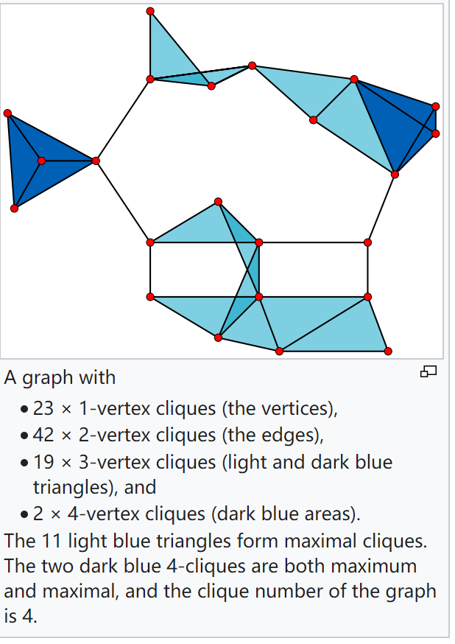
Clique
A clique in a graph G is a subset of vertices in the graph such that each pair of vertices in the subset is connected by an edge in the graph G.
Finding whether there is a clique of a given size in a graph (the clique problem) is NP-complete.

Slide 25
Clique
A maximal clique (极大团) is a clique that cannot be extended by including one more adjacent vertex, that is, a clique which does not exist exclusively within the vertex set of a larger clique.
A maximum clique ( 最大团) is a clique of the largest possible size in a given graph. The clique number ω(G) of a graph G is the number of vertices in a maximum clique in G.
5
Maximal clique:
(1,2,3)
(1,3,4,5)
A maximum clique:
(1,3,4,5)
1
4
2
3

Slide 26
Clique
1
Basic Algorithm:
R=null; and P=V(G); // V(G) denotes all vertices in G
FindingMaximalClque(R,P):
if P is empty:
report R as a maximal clique
for each vertex v in P:
FindingMaximalClque (R ⋃ {v}, P ⋂ N(v))
// N(v) denotes all v’s neighbor vertices.
2
3
→ (1,2 ) → (1,2,3)
(1) → (1,3 ) → (1,3,2)
Problem: It may generate duplicate answers.

Slide 27
Clique
1
R=null; and P=V(G); // V(G) denotes all vertices in G
FindingMaximalClque(R,P):
if P is empty:
report R as a maximal clique
for each vertex v in P:
FindingMaximalClque (R ⋃ {v}, P ⋂ N(v))
// N(v) denotes all v’s neighbor vertices.
P=P\ {v};
2
3
→ (1,2 ) → (1,2,3)
(1) → (1,3 )
Problem: It may generate some un-maximal clique.

Slide 28

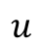
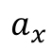
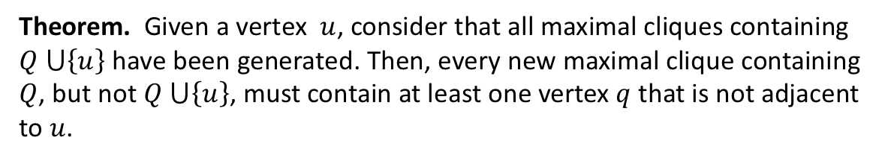
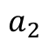
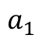
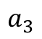
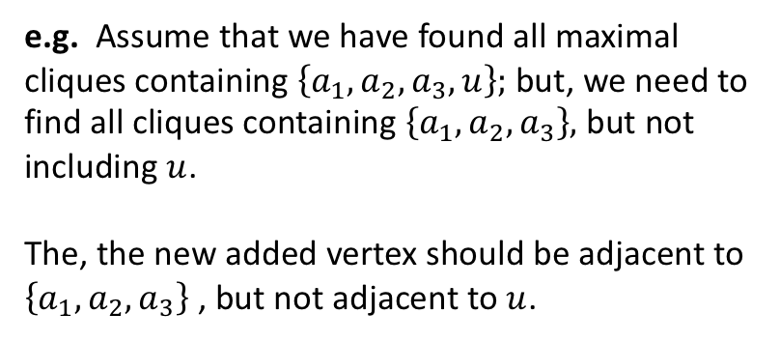
Clique
Theorem. Given a vertex $u$, consider that all maximal cliques containing $Q ⋃\left\{u\right\}$ have been generated. Then, every new maximal clique containing $Q$, but not $Q ⋃\left\{u\right\}$, must contain at least one vertex $q$ that is not adjacent to $u$.
e.g. Assume that we have found all maximal cliques containing $\left\{a_{1},a_{2},a_{3},u\right\};$ but, we need to find all cliques containing $\left\{a_{1},a_{2},a_{3}\right\},$ but not including $u$.
The, the new added vertex should be adjacent to $\left\{a_{1},a_{2},a_{3}\right\}$ , but not adjacent to $u$.
$$a_{1}$$
$$u$$
$$a_{2}$$
$$a_{3}$$
$$a_{x}$$

Slide 29
Clique
Bron–Kerbosch algorithm
R=null; and P=V(G); // V(G) denotes all vertices in G
FindingMaximalClque(R,P, X):
if P and X are both empty:
report R as a maximal clique
for each vertex v in P:
FindingMaximalClque (R ⋃ {v}, P ⋂ N(v), X ⋂ N(v))
// N(v) denotes all v’s neighbor vertices.
P=P\ {v};
X= X ⋃ {v}; // why ???
Notes:
X表示已经考虑过的节点集合。 P非空，表示，目前找到这个clique还可以包含一个P里面的节点，使得其扩大。但是包含X节点极大团已经被考虑过了。所以结束的条件是P和X都必须为空。

Slide 30
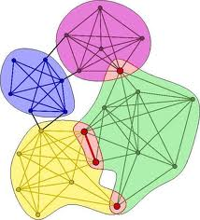
Clique Percolation
Uncovering the overlapping community structure [Palla et al., Nature, 2005]

Slide 31
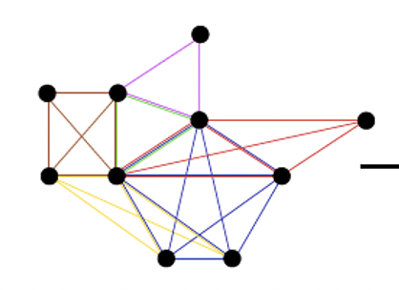
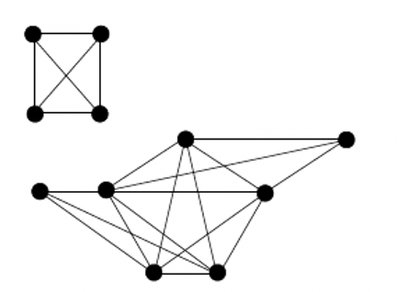
Clique Percolation
k-clique community: [Palla et al., Nature, 2005]
A union of all k-cliques (complete subgraphs of size k) that can be reached from each other through a series of adjacent k-cliques (where adjacency means sharing k-1 nodes.)
e.g. k=4-clique community
Notes:
X表示已经考虑过的节点集合。 P非空，表示，目前找到这个clique还可以包含一个P里面的节点，使得其扩大。但是包含X节点极大团已经被考虑过了。所以结束的条件是P和X都必须为空。

Slide 32
Clique Percolation
Finding k-clique community Algorithm:
Locating all maximal cliques in the graph.
Build a clique-clique overlap matrix, where each row (and column) represents a clique and the matrix elements are equal to the size of the number of common nodes between the corresponding two cliques, and the diagonal entries are equal to the size of the clique.
Erase off-diagonal entry smaller than k-1 and every diagonal element smaller than k in the matrix, replacing the remaining elements by one.
The resulting separate components are equivalent to the different k-clique-communities.
Notes:
X表示已经考虑过的节点集合。 P非空，表示，目前找到这个clique还可以包含一个P里面的节点，使得其扩大。但是包含X节点极大团已经被考虑过了。所以结束的条件是P和X都必须为空。

Slide 33
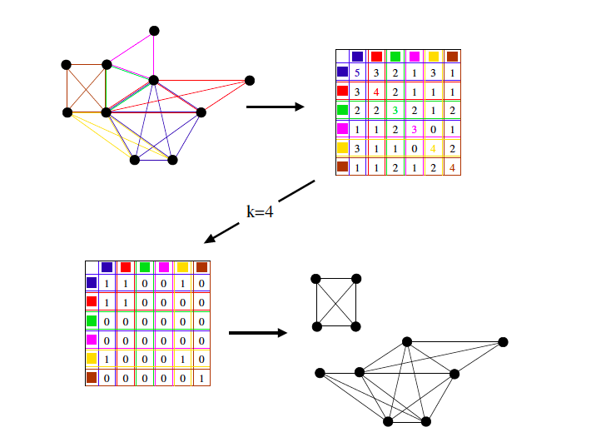
Clique Percolation

Slide 34
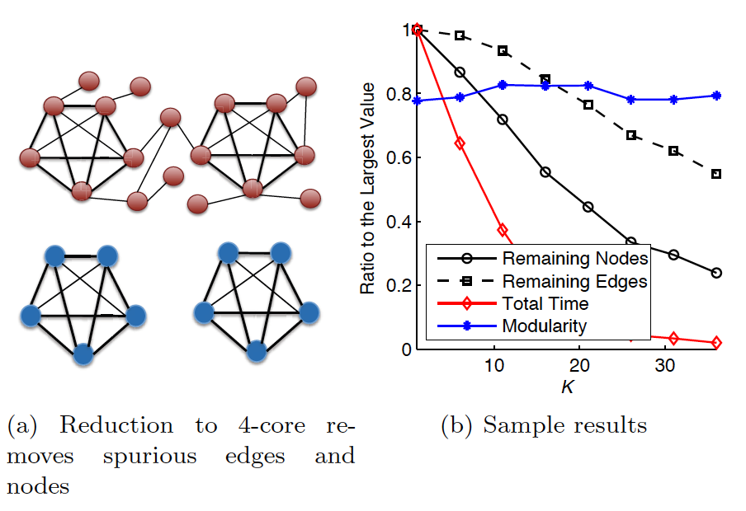
K-core
K-core. The K-core of a graph is the largest subgraph within which each node has at least K connections.

Slide 35
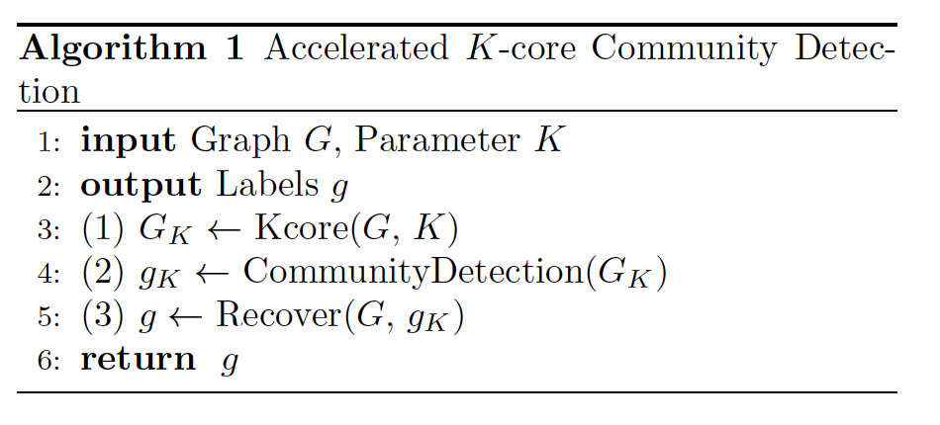
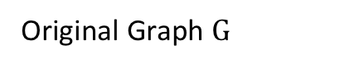
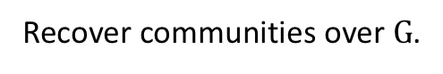
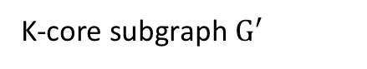
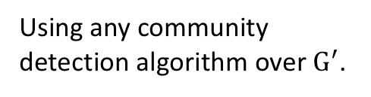
K-core
Original Graph $G$
K-core subgraph $G^{′}$
Using any community detection algorithm over $G^{′}$.
Recover communities over $G$.

Slide 36
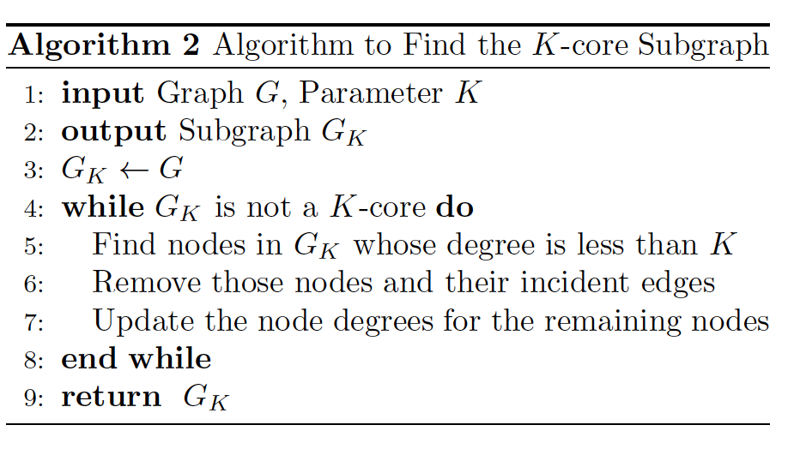
K-core
Finding k-core Subgraph

Slide 37
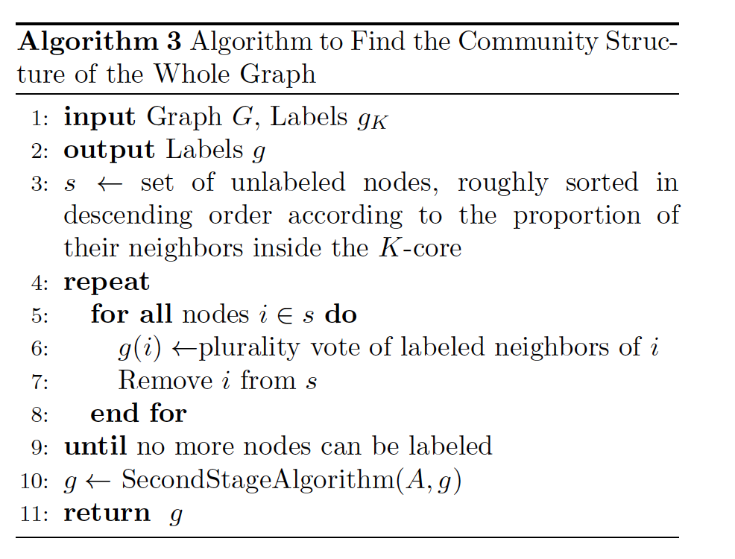
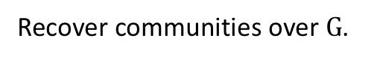
K-core
Recover communities over $G$.

Slide 38
Part 2
Community-Affiliation Graph
[Yang and Leskovec, WSDM 2013]
this part slides are from http://www.mmds.org

Slide 39
Motivation
1) Given a model, we generate the network:
2) Given a network, find the “best” model
Generative model for networks
B
A
F
D
E
C
G
H
B
Generative model for networks
A
F
D
E
C
G
H

Slide 40
Models of Networks
Goal: Define a model that can generate networks
The model will have a set of “parameters” that we will later want to estimate (and detect communities)
Q: Given a set of nodes, how do communities “generate” edges of the network?
Generative model for networks
B
A
F
D
E
C
G
H

Slide 41


Community-Affiliation Graph
Communities, C
p_{A}
p_{B}
Model
Memberships, M
Nodes, V
Model
Network
Generative model B(V, C, M, {p_{c}}) for graphs:
Nodes V, Communities C, Memberships M
Each community c has a single probability p_{c}
Later we fit the model to networks to detect communities

Slide 42



AGM: Generative Process
Communities, C
p_{A}
p_{B}
Model
Memberships, M
Nodes, V
Community Affiliations
Network
AGM generates the links: For each
For each pair of nodes in community $A$, we connect them with prob. $p_{A}$
The overall edge probability is:
$M_{u}$ … set of communities node $u$ belongs to
If $u,v$ share no communities: $P\left(u,v\right)=ε$
Think of this as an “OR” function: If at least 1 community says “YES” we create an edge

Slide 43


Recap: AGM networks
Model
Network

Slide 44



AGM: Flexibility
AGM can express a variety of community structures: Non-overlapping, Overlapping, Nested

Slide 45
How do we detect communities with AGM?

Slide 46


Detecting Communities
Detecting communities with AGM:
B
A
F
D
E
C
G
H
Given a Graph $G(V,E)$, find the Model
Affiliation graph M
Number of communities C
Parameters p_{c}

Slide 47

Maximum Likelihood Estimation
Maximum Likelihood Principle (MLE):
Given: Data $X$
Assumption: Data is generated by some model $f(Θ)$
$f$ … model
$Θ$ … model parameters
Want to estimate $P_{f}\left(X\right|Θ)$:
The probability that our model $f$ (with parameters $Θ$) generated the data
Now let’s find the most likely model that could have generated the data: $\underset{Θ}{arg max}{ P}_{f}\left(X\right|Θ)$

Slide 48





Example: MLE
Imagine we are given a set of coin flips
Task: Figure out the bias of a coin!
Data: Sequence of coin flips: $X=[1, 0, 0, 0, 1,0,0,1]$
Model: $f\left(Θ\right)=$ return 1 with prob. $Θ,$ else return 0
What is $P_{f}\left(X | Θ\right)$? Assuming coin flips are independent
So, $P_{f}\left(X | Θ\right)=P_{f}\left(1 | Θ\right)∗P_{f}\left(0 | Θ\right)∗P_{f}\left(0 | Θ\right)…∗P_{f}\left(1 | Θ\right)$
What is $P_{f}\left(1 | Θ\right)$? Simple, $P_{f}\left(1 | Θ\right)=Θ$
Then, $P_{f}\left(X | Θ\right)=Θ^{3}{\left(1−Θ\right)}^{5}$
For example:
$P_{f}\left(X | Θ=0.5\right)=0.003906$
$P_{f}\left(X | Θ=\frac{3}{8}\right)=0.005029$
What did we learn? Our data was most likely generated by coin with bias $Θ=3/8$
$$Θ^{∗}=3/8$$
$$P_{f}\left(X | Θ\right)$$
$$Θ$$

Slide 49



MLE for Graphs
How do we do MLE for graphs?
Model generates a probabilistic adjacency matrix
We then flip all the entries of the probabilistic matrix to obtain the binary adjacency matrix $A$
The likelihood of AGM generating graph G:
Flip biased coins
$$A$$
For every pair of nodes $u,v$ AGM gives the prob. $p_{uv}$ of them being linked
0 | 0.10 | 0.10 | 0.04
0.10 | 0 | 0.02 | 0.06
0.10 | 0.02 | 0 | 0.06
0.04 | 0.06 | 0.06 | 0
0 | 1 | 0 | 0
1 | 0 | 1 | 1
0 | 1 | 0 | 1
0 | 1 | 1 | 0

Slide 50
Graphs: Likelihood P(G|Θ)
Given graph G(V,E) and Θ, we calculate likelihood that Θ generated G: P(G|Θ)
G
0 | 0.9 | 0.9 | 0
0.9 | 0 | 0.9 | 0
0.9 | 0.9 | 0 | 0.9
0 | 0 | 0.9 | 0
0 | 1 | 1 | 0
1 | 0 | 1 | 0
1 | 1 | 0 | 1
0 | 0 | 1 | 0
A
B
G
Θ=B(V, C, M, {p_{c}})
P(G|Θ)

Slide 51





MLE for Graphs
Our goal: Find $Θ=B(V,C,M,\left\{p_{C}\right\})$ such that:
How do we find $B(V,C,M,\left\{p_{C}\right\})$ that maximizes the likelihood?
P(
|
)
$$G$$
AGM
arg max

Slide 52

MLE for AGM
Our goal is to find $B\left(V,C,M,\left\{p_{C}\right\}\right)$ such that:
$$\underset{B(V,C,M,\left\{p_{C}\right\})}{arg max}{\prod_{u,v∈E}{P(u,v){\prod_{uv∉E}{(1−P\left(u,v\right)})}^{}}}$$
Problem: Finding B means finding the bipartite affiliation network.
There is no nice way to do this.
Fitting $B(V,C,M,\left\{p_{C}\right\})$ is too hard, let’s change the model (so it is easier to fit)!

Slide 53


From AGM to BigCLAM
Relaxation: Memberships have strengths
$F_{uA}:$ The membership strength of node $u$ to community $A$ ($F_{uA}=0$: no membership)
Each community $A$ links nodes independently:
$$P_{A}\left(u,v\right)=1−exp⁡(−F_{uA}⋅F_{vA}^{})$$
$$F_{uA}$$
u
v

Slide 54





Factor Matrix $F$
Community membership strength matrix $F$
Communities
 | j
$P_{A}\left(u,v\right)=1−exp⁡(−F_{uA}⋅F_{vA}^{})$
Probability of connection is proportional to the product of strengths
Notice: If one node doesn’t belong to the community ($F_{uC}=0$) then $P(u,v)=0$
Prob. that at least one common community $C$ links the nodes:
$P\left(u,v\right)=1−\prod_{C}{\left(1−P_{C}\left(u,v\right)\right)}$
Nodes
$$F=$$
$F_{u}$ … vector of
community membership strengths of $u$
$F_{vA}$ …
strength of $u$’s membership to $A$

Slide 55





From AGM to BigCLAM
Community $A$ links nodes $u,v$ independently: $P_{A}\left(u,v\right)=1−exp⁡(−F_{uA}⋅F_{vA}^{})$
Then prob. at least one common $C$ links them:
$P\left(u,v\right)=1−\prod_{C}{\left(1−P_{C}\left(u,v\right)\right)}$
$=1−exp⁡(−\sum_{C}{F_{uC}⋅F_{vC}})$
$$=1−exp⁡(−F_{u}⋅F_{v}^{T})$$
Example $F$ matrix:
$$F_{u}^{}:$$
0 | 1.2 | 0 | 0.2
Then: $F_{u}⋅F_{v}^{T}=0.16$
And: $P\left(u,v\right)=1−exp\left(−0.16\right)=0.14$
But: $P\left(u,w\right)=0.88$
$P\left(v,w\right)=0$
$$F_{v}^{}:$$
0.5 | 0 | 0 | 0.8
$$F_{w}^{}:$$
0 | 1.8 | 1 | 0
Node community membership strengths

Slide 56


BigCLAM: How to find F
Task: Given a network $G(V,E)$, estimate $F$
Find $F$ that maximizes the likelihood:
$$arg max_{F} \prod_{(u,v)∈E}{P(u,v})\prod_{\left(u,v\right)∉E}{(1−P\left(u,v\right))}$$
where: $P(u,v)=1−exp⁡(−F_{u}⋅F_{v}^{T})$
Many times we take the logarithm of the likelihood, and call it log-likelihood: $l\left(F\right)=log⁡P(G|F)$
Goal: Find $F$ that maximizes $l(F)$:

Slide 57




BigCLAM: V1.0
Compute gradient of a single row $F_{u}$ of $F$:
Coordinate gradient ascent:
Iterate over the rows of $F$:
Compute gradient $∇l\left(F_{u}\right)$ of row $u$ (while keeping others fixed)
Update the row $F_{u}$: $F_{u}←F_{u}+η ∇l(F_{u})$
Project $F_{u}$ back to a non-negative vector: If $F_{uC}<0$: $F_{uC}=0$
This is slow! Computing $∇l\left(F_{u}\right)$ takes linear time!
$𝓝(u)$.. Set out outgoing neighbors

Slide 58


BigCLAM: V2.0
However, we notice:
We cache $\sum_{v}{F_{v}}$
So, computing $\sum_{v∉𝓝(u)}{F_{v}}$ now takes linear time in the degree $|𝓝\left(u\right)|$ of $u$
In networks degree of a node is much smaller to the total number of nodes in the network, so this is a significant speedup!

Slide 59
Part 3
Community Search

Slide 60

Community Search
The only part we are interested in.
Query node

Slide 61


Community Search
Problem Definition: Given an undirected connected graph $G(V,E)$, a set of query nodes Q, where , and a goodness function $Q$, we seek to find an induced subgraph $H(V_{H},E_{H}$) of $G$, such that
$V_{H}$ contains all nodes in $Q$;
$H$ is connected;
$f(H)$ is maximized among all feasible choices for $H$.
The goodness function $f(H)$ is defined as the minimal degree of any node of $V_{H}$ in the induced subgraph.
$Q⊂V$

Slide 62
Community Search VS. Community Search
Community detection: divides the entire network to find communities
Too costly
Unfriendly to dynamic changing graphs
Notes:
However, community detection still has some weaknesses. It’s too costly and unfriendly to dynamic changing graphs.

Slide 63
Community Search VS. Community Search
Friend recommendation on Facebook
Advertising on social networks
Infectious disease control
Semantic expansion
Notes:
The community search problem is also motivated by many real applications. For example, in friend recommendation on facebook. Given the friendship network, the system wants to suggest candidate friends to a specific user. Intuitively, we will only recommend to the user those who are in the same community as he is, but are not yet his friends. Some other typical applications includes the Advertising on social networks
, infectious disease control, and semantic expansion.

Slide 64

Community Search - Global Search [Sozio & Gionis, KDD 02]
Algorithm (GREEDY)
We start by setting $G_{0}=G$, the input graph, and we proceed by deleting one node in each step.
At the t-th step, we consider a node u that has the minimum degree in G_{t-1}.
Consequently, at the t-th step, we obtain graph $G_{t}$ by deleting the node u and all the edges incident to u from G_{t-1}.
Assume that the node to be deleted in (T-1)-step is denoted as x. The algorithm terminates at the T-th step if and only if the one of the following conditions hold:
(1) deleting x in the (T-1)-th step leads to dis-connectivity of query nodes; or
(2) x is one the query nodes.
If G_{t} is the graph during the t-th step of the algorithm, we denote by G_{t}’ the connected component of G_{t} that contains all query nodes Q. Let f_{m}(G_{t}’ ) be the minimum degree of the nodes in G_{t}’ .
G_{opt}= arg max{f_{m}(G_{t}’ ) | t=1,…, T-1}.

Slide 65
Community Search - Global Search [Sozio & Gionis, KDD 02]
Theorem 1:
Let G be a graph and Q be a set of query nodes. The algorithm GREEDY returns an optimum solution for the community search problem.
PROOF. Let G_{t} be the graph at step t, and G_{opt} be the optimum solution for the problem. Obviously, G_{opt} G_{0.}
Consider the t-th step. Let G_{t}’ be the connected component of G_{t} containing all query nodes.
Assume G_{opt} G_{t}’,
If the minimum degree in G_{t}’ is vertex x and x ∈ G_{opt,} we know that for any vertex u in G_{t}’, the following equation holds.
Notes:
上述公式表明G_{t}’中的任何一个结点u的degree，至少不比Gopt中的结点x的degree小；
说明根据goodness函数，最优解是指包含所有查询节点的连同图中，最小的节点degre最大的那个子图。
根据上面的定义，
G_{t}’至少不比Gopt差；所以意味这时候的G_{t}’就是Gopt。
这时候，要证明定理成立，只用证明，算法在不删除Gopt中的一任何个点之前，迭代删除点的过程是不可能停止的。
这个容易证明，因为如果Gopt中的任何点都不被删除，则剩下的图一定包含所有查询点，并且还是连同的；这时候没有达到算法的停止条件；故而，算法不会停止。

Slide 66
Community Search - Global Search [Sozio & Gionis, KDD 02]
It implies that G_{t}’ is the optimum solution.
The above analysis has the following conclusion:
At (t+1)-th step, assume that the node to be deleted is x.
It means that x is the minimum degree in the previous step (t-th step).
If x ∈ G_{opt,} G_{t}’ must be the optimum solution.
Initially, G_{opt} G₀’.
In order to prove the theorem, we only need to prove the following statement.
“The algorithm cannot terminate before deleting some vertex in G_{opt}”. (WHY?)

Slide 67
Community Search - Global Search [Sozio & Gionis, KDD 02]
Assume that the algorithm terminates before deleting some vertex in G_{opt} (proof by contradiction)
According the algorithm termination conditions,the query nodes are not disconnected or one of query points is deleted.
Obviously, it is impossible to satisfy the termination condition if the algorithm runs before deleting some vertex in G_{opt.}
Therefore, the theorem holds #.

Slide 68
k-truss and
community search

Slide 69
k-truss
[Jonathan Cohen, 2008]
k-truss of graph G: the largest subgraph H s.t. every edge in H is contained in at least (k-2) triangles within H.
trussness((p_{2,}q)) = 4
K-truss itself is not
a good enough community model
2-truss
p₁
p₂
s₁
s₂
p₄
3-truss
p₃
t
q
x₁
s₃
s₄
4-truss
r₁
The 4-truss is disconnected with two components
r₂
r₃
x₂
k_{max}= 4

Slide 70

k-truss
[Support] The support of an edge $e=\left(u,v\right)∈E_{G}$ in $G$, denoted as $\sup\left(e,G\right),$ is defined as $|\{∆_{uvw}:∆_{uvw}∈∆_{G}\}|$, where $∆_{G}$ is a set of triangles in graph $G$.
[Subgraph Trussness]. The trussness of a subgraph $H⊑G$ is the minimum support of an edge in $H$, denoted as $τ\left(H\right)=min⁡\{\sup\left(e,H\right):e∈E(H)\}$
[Edge Trussness]. The trussness of an edge $e∈E\left(G\right)$ is defined as $τ\left(e\right)=\max_{H⊑G}{\{τ\left(H\right):e∈E(H)\}}$. Obviously, $τ\left(e\right)≤sup⁡(e)$.
[k-Class]. The k-class of $G$, denoted as $Φ_{k}$, is defined as $\{e:e∈E\left(G\right), τ\left(e\right)=k\}$

Slide 71






Truss Decomposition in Massive Networks [﻿Jia Wang, et al., VLDB 2012]
$$u$$
$$w_{1}$$
……
$$v$$
$$w_{2}$$
$$\deg\left(u\right)<deg⁡(v)$$

Slide 72


K-Truss Community Model [﻿Huang et al., SIGMOD 14]
Triangle adjacency: $∆1$ $∩$ $∆2≠∅$
Edge connectivity in graph G’:
$e1∈∆1$, $e2∈∆2$
$∆1$ $=∆2$ or $∆1$ is triangle connected with $∆2$ in graph G’.
a common edge
$∆tp1p2 is triangle adjacent with ∆qp1p2$.
Thus, e(t, p₁) is edge connected with e(q, p₂).
But, e(t, p₁) is not edge connected with e(t, r₂).
p₁
p₂
s₁
s₂
p₃
p₄
t
q
x₁
s₃
s₄
r₁
r₂
r₃
x₂

Slide 73
K-Truss Community Model [﻿Huang et al., SIGMOD 14]
A k-truss community satisfies:
(1) K-truss: each edge within at least (k-2) triangles
(2) Edge Connectivity: all pairs of edges
(3) Maximal Subgraph
p₁
p₂
s₁
s₂
C₁
p₃
p₄
t
q
x₁
s₃
s₄
r₁
C₂
r₂
r₃
x₂
Two 4-truss communities for q

Slide 74
K-Truss Community Model [﻿Huang et al., SIGMOD 14]
Cohesive structure
Bounded diameter
A k-truss community with |C| vertices, the diameter is no larger than ⌊ (2|C|-2)/k⌋.
(K-1)-edge-connected graph
Only one parameter to set
Polynomial time algorithm
A 4-truss community
p₁
p₂
C₁
p₃
p₄
t
q
Diameter upper bound ⌊(2*6-2)/4 ⌋=2
3-edge-connected graph

Slide 75
[﻿Huang et al., SIGMOD 14]
Problem: Given a graph G(V, E) , a query vertex q and an integer k ≥ 3, ﬁnd all k-truss communities containing q.
p₁
p₂
s₁
s₂
C₁
p₃
p₄
t
q
x₁
s₃
s₄
r₁
C₂
r₂
r₃
x₂
Two 4-truss communities for q

Slide 76
[﻿Huang et al., SIGMOD 14]
Index Construction (offline)
Keep some known information into a data structure in advance.
Query Processing (online)
Based on the index, efficiently search for k-truss community.

Slide 77
Framework [﻿Huang et al., SIGMOD 14]
Applying a truss decomposition algorithm on graph
For each vertex x, keep all its neighbors N(x) in decreasing order of edge trussness.
In addition, build a hash table for looking up the edge trussness.
s₁
s₂
Vertex | Simple K-Truss Index
q | {[x₁,5], [x₂,5], [x₃,5], [x₄,5], [s₁,5], [s₂,5], [s₃,5], [s₄,5], [r₂,3], [r₂,3], [p,3]}
x₁ | {[q,5], [x₂,5], [x₃,5], [x₄,5], [s₂,4]}
x₂ | …
… | …
x₁
x₄
5-truss edge
s₄
s₃
q
4-truss edge
p
x₂
x₃
r₁
r₂
3-truss edge

Slide 78

Framework [﻿Huang et al., SIGMOD 14]
s₁
s₂
x₁
x₄
5-truss edge
s₄
s₃
q
4-truss edge
p
x₂
x₃
r₁
r₂
3-truss edge
Vertex | Simple K-Truss Index
q | {[x₁,5], [x₂,5], [x₃,5], [x₄,5], [s₁,5], [s₂,5], [s₃,5], [s₄,5], [r₂,3], [r₂,3], [p,3]}
x₁ | {[q,5], [x₂,5], [x₃,5], [x₄,5], [s₂,4]}
x₂ | …
… | …

Slide 79

Query Processing using Simple K-Truss Index
Querying 5-truss communities containing vertex q
Queue
(q, s₂)
(q, s₁)
(s₁, s₂)
(q, s₃)
(s₂, s₃)
(q, s₄)
(s₂, s₄)
(s₁, s₃)
(s₁, s₄)
(s₃, s₄)
Visited
(q, s₂)
(q, s₁)
(s₁, s₂)
(q, s₃)
(s₂, s₃)
(q, s₄)
(s₂, s₄)
(s₁, s₃)
(s₁, s₄)
(s₃, s₄)
5-truss community
$τ$((s₂, x₁))=4<5
BFS Traversal
s₁
s₂
x₁
x₄
5-truss edge
s₄
s₃
q
4-truss edge
p
x₂
x₃
r₁
r₂
3-truss edge

Slide 80
Part 4
Graph Partition

Slide 81


A graph and a partition into two subsets $S$ and -S

Slide 82
Min Cut & Graph Partition
Quality Functions
[J. Shi and J. Malik, PAMI, 2000]
[Kannan et al., FOCS, 2000]

Slide 83
The Kernighan-Lin(KL) algorithm [Kernighan-Lin, 1970]
Min Cut & Graph Partition
Quality Functions
KL objective function i.e. minimize the edge cut while keeping the cluster sizes balanced.
Basic Idea:
The algorithm is iterative in nature and starts with an initial bipartition of the graph. At each iteration, the algorithm searches for a subset of vertices from each part of the graph such that swapping them will lead to a reduction in the edge cut. The identification of such subsets is via a greedy procedure.
The gain of a vertex v is the reduction in edge-cut if vertex v is moved from its current partition to the other partition.

Slide 84
Multi-Level Graph Partitioning [Karypis and Kumar, 1999, SIAM J]
Min Cut & Graph Partition
Coarsening
The goal here is to produce a smaller graph that is similar to the original graph. This step may be applied repeatedly to obtain a graph that is small enough to be partitioned quickly and with high quality.
Initial Partitioning
In this step, a partitioning of the coarsest graph is performed.
Uncoarsening
In this phase, the partition on the current graph is used to initialize a partition on the finer (bigger) graph.

Slide 85


Multi-Level Graph Partitioning [Karypis and Kumar, 1999, SIAM J]
Min Cut & Graph Partition
A matching-based Coarsening

Slide 86
References
Price, Derek J. De Solla. "Networks of scientific papers." Science (1965): 510-515.
Barabási, Albert-László, and Réka Albert. "Emergence of scaling in random networks." Science 286.5439 (1999): 509-512.
Dorogovtsev, Sergey N., José Fernando F. Mendes, and Alexander N. Samukhin. "Structure of growing networks with preferential linking." Physical review letters 85.21 (2000): 4633.
Bollobás, B´ ela, et al. "The degree sequence of a scale‐free random graph process." Random Structures & Algorithms 18.3 (2001): 279-290.
Newman, Mark EJ. "Power laws, Pareto distributions and Zipf's law." Contemporary physics 46.5 (2005): 323-351.
Bollobás, Béla, and Oliver Riordan. "The diameter of a scale-free random graph." Combinatorica 24.1 (2004): 5-34.
P. L. Krapivsky, . Redner, S., and . Leyvraz, F., “Connectivity of growing random networks,” PRL, vol. 85, no. 21, pp. 4629–32, 2000.

Slide 87
References
Mauro Sozio, Aristides Gionis: The community-search problem and how to plan a successful cocktail party. KDD 2010: 939-948
J. Shi and J. Malik. Normalized Cuts and Image Segmentation. IEEE Transactions on Pattern Analysis and Machine Intelligence, 22(8):888-905, 2000
R. Kannan, S. Vempala, and A. Veta. On clusterings-good, bad and spectral. In FOCS ’00, page 367. IEEE Computer Society, 2000.
B. Kernighan and S. Lin. An Efficient Heuristic Procedure for partitioning graphs. The Bell System Technical J., 49, 1970
G. Karypis and V. Kumar. A fast and high quality multilevel scheme for partitioning irregular graphs. SIAM Journal on Scientic Computing, 20, 1999.
Cohen J, Trusses: Cohesive subgraphs for social network analysis, NSA technique report.
Chengbin Peng, Tamara G. Kolda, Ali Pinar:
Accelerating Community Detection by Using K-core Subgraphs. CoRR abs/1403.2226 (2014)
Jaewon Yang, Jure Leskovec: Overlapping community detection at scale: a nonnegative matrix factorization approach. WSDM 2013: 587-596
M. Girvan and M. E. J. Newman, Community structure in social and biological networks, PNAS. USA 99, 7821–7826 (2002)

